Slide 1
MTK 1 D
IF E
Samuel Haganta Surbakti (24060124130120)
Wipin Saputra Poh (24060124130080)
Yustinus Hendi Setyawan (24060124130114)

Slide 2

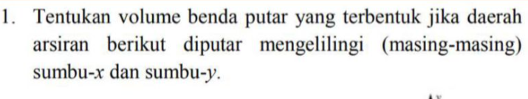
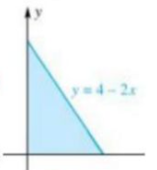
Soal

Slide 3
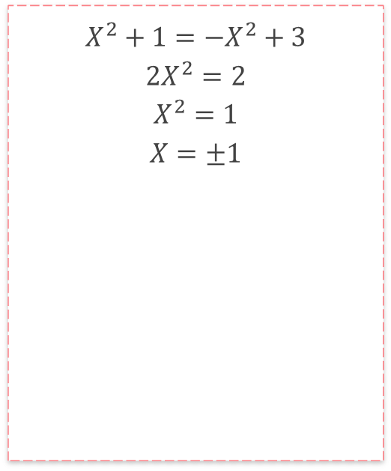
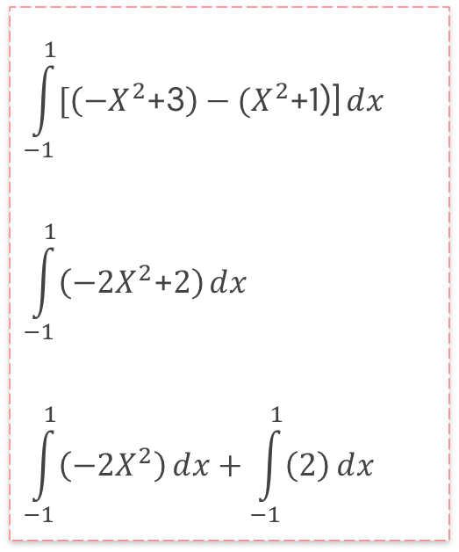
$$X^{2}+1={−X}^{2}+3$$
$$2X^{2}=2$$
$$X^{2}=1$$
$$X=±1$$
$$\int_{−1}^{1}{[\left({−X}^{2}\text{+3}\right)−{(X}^{2}\text{+1}\text{)]}ⅆx}$$
$$\int_{−1}^{1}{\left({−2X}^{2}\text{+}2\right)ⅆx}$$
$$\int_{−1}^{1}{\left({−2X}^{2}\right)ⅆx}+\int_{−1}^{1}{\left(2\right)ⅆx}$$

Slide 4
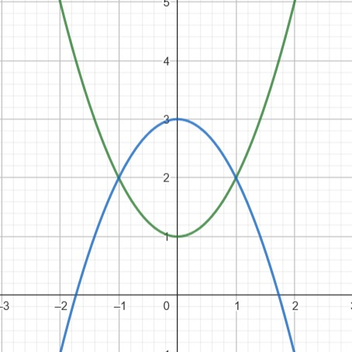

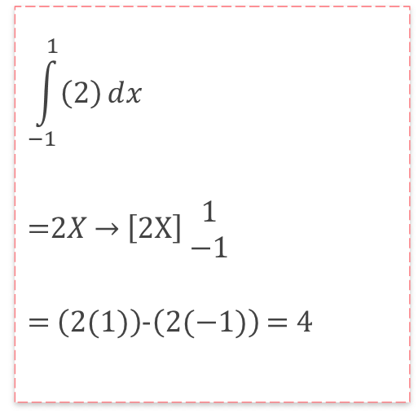
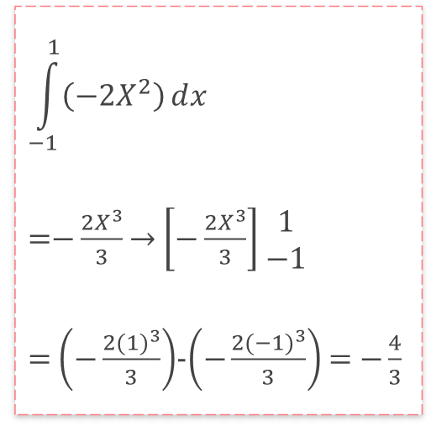
$$\int_{−1}^{1}{\left({−2X}^{2}\right)ⅆx}$$
=$−\frac{2X^{3}}{3}$ → $\left[−\frac{2X^{3}}{3}\right]$ $\begin{matrix}1 \\ −1\end{matrix}$
= $\left(−\frac{2{(1)}^{3}}{3}\right)$-$\left(−\frac{2{(−1)}^{3}}{3}\right)$ = $−\frac{4}{3}$
$$\int_{−1}^{1}{\left(2\right)ⅆx}$$
=$2X$ → $\left[2X\right]$ $\begin{matrix}1 \\ −1\end{matrix}$
= $\left(2(1)\right)$-$\left(2(−1)\right)$ = $4$
$−\frac{4}{3}$ + $\frac{12}{3}$ = $\frac{8}{3}$

Slide 5
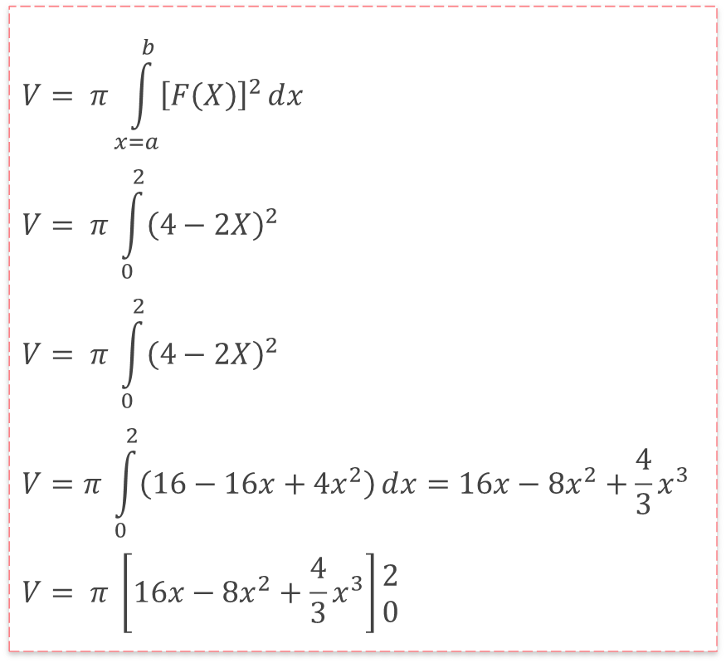
$$V= π\int_{x=a}^{b}{{\left[F\left(X\right)\right]}^{2}ⅆx}$$
$$V= π \int_{0}^{2}{{\left(4−2X\right)}^{2}}$$
$$V= π \int_{0}^{2}{{\left(4−2X\right)}^{2}}$$
$$V=π \int_{0}^{2}{\left(16−16x+4x^{2}\right)ⅆx=16x−8x^{2}+\frac{4}{3}x^{3}}$$
$$V= π \left[16x−8x^{2}+\frac{4}{3}x^{3}\right]\begin{matrix}2 \\ 0\end{matrix}$$

Slide 6
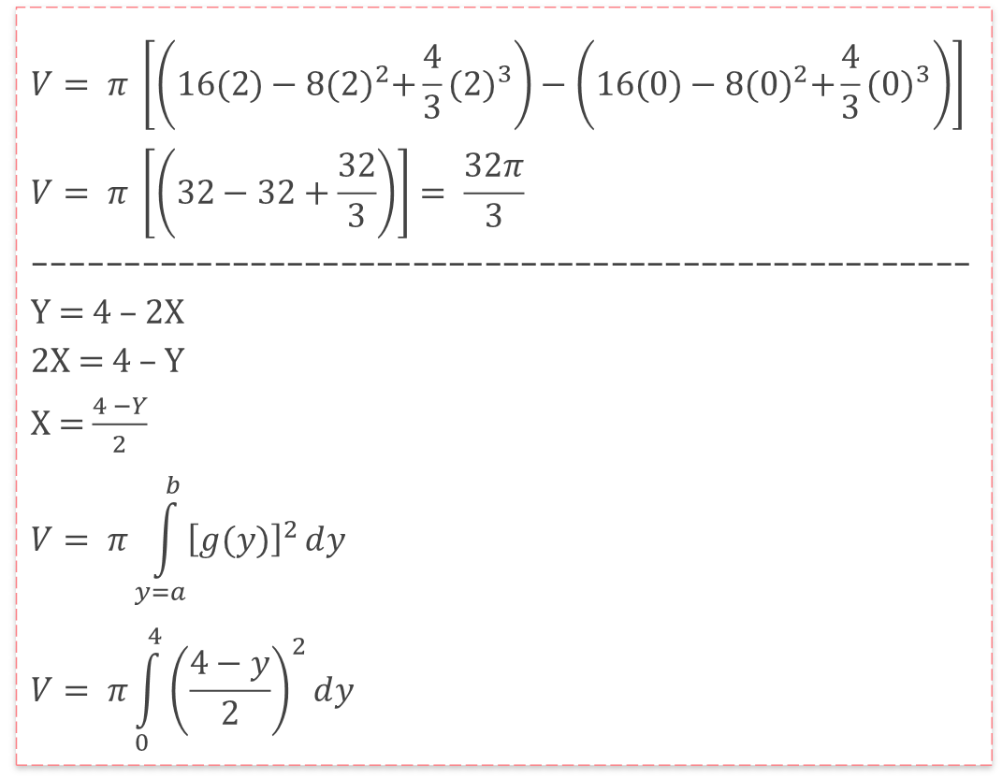
$$V= π \left[\left(16(2)−8{(2)}^{2}+\frac{4}{3}{(2)}^{3}\right)−\left(16(0)−8{(0)}^{2}+\frac{4}{3}{(0)}^{3}\right)\right]$$
$$V= π \left[\left(32−32+\frac{32}{3}\right)\right]= \frac{32π}{3}$$
----------------------------------------------------
Y = 4 – 2X
2X = 4 – Y
X = $\frac{4 −Y}{2}$
$$V= π\int_{y=a}^{b}{{\left[g(y)\right]}^{2}ⅆy}$$
$$V= π\int_{0}^{4}{{\left(\frac{4−y}{2}\right)}^{2}ⅆy}$$

Slide 7
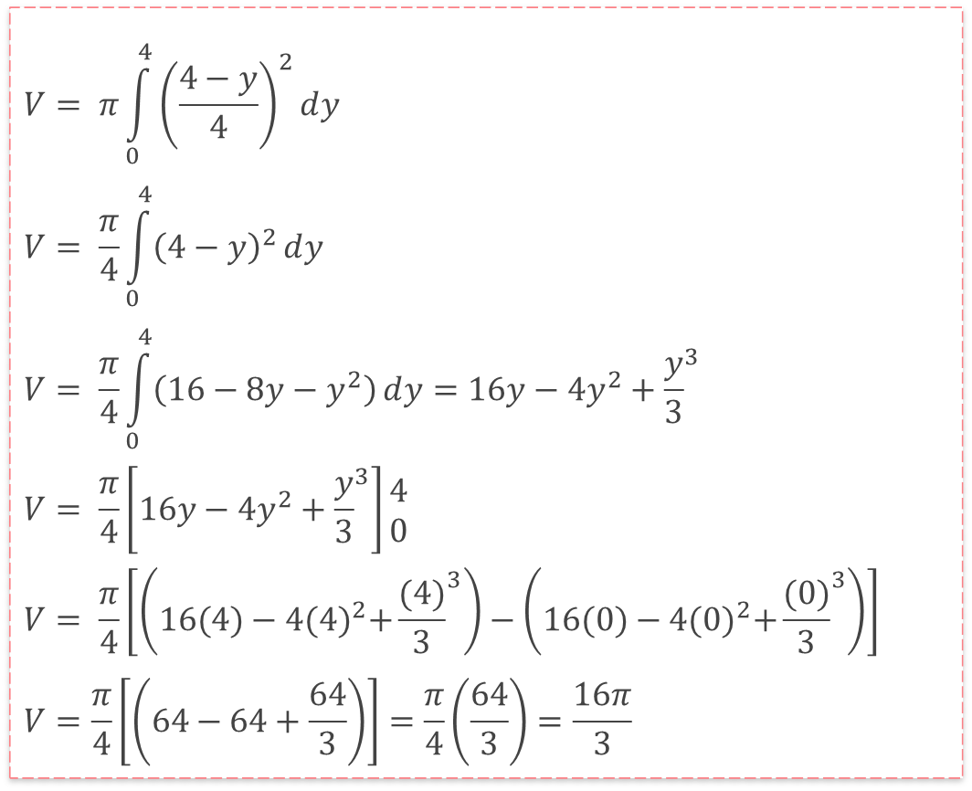
$$V= π\int_{0}^{4}{{\left(\frac{4−y}{4}\right)}^{2}ⅆy}$$
$$V= \frac{π}{4}\int_{0}^{4}{{\left(4−y\right)}^{2}ⅆy}$$
$$V= \frac{π}{4}\int_{0}^{4}{\left(16−8y−y^{2}\right)ⅆy=16y−4y^{2}+{\frac{y}{3}}^{3}}$$
$$V= \frac{π}{4}\left[16y−4y^{2}+{\frac{y}{3}}^{3}\right]\begin{matrix}4 \\ 0\end{matrix}$$
$$V= \frac{π}{4}\left[\left(16(4)−4{(4)}^{2}+{\frac{(4)}{3}}^{3}\right)−\left(16(0)−4{(0)}^{2}+{\frac{(0)}{3}}^{3}\right)\right]$$
$$V=\frac{π}{4}\left[\left(64−64+\frac{64}{3}\right)\right]=\frac{π}{4}\left(\frac{64}{3}\right)=\frac{16π}{3}$$

Slide 8

Thanks!
Do you have any questions?

